Slide 1

Protocol of Reconciliation & Grace Through Separation

Slide 2

The Mediation Team
Bishop Yambasu and Central Conference bishops called the group together in July, 2019 in Chicago
US Bishops
Members of Central Conferences
Progressives, Traditionalists, Centrists representing a variety of groups in the UMC
No budget. All volunteer. No authority.

Slide 3

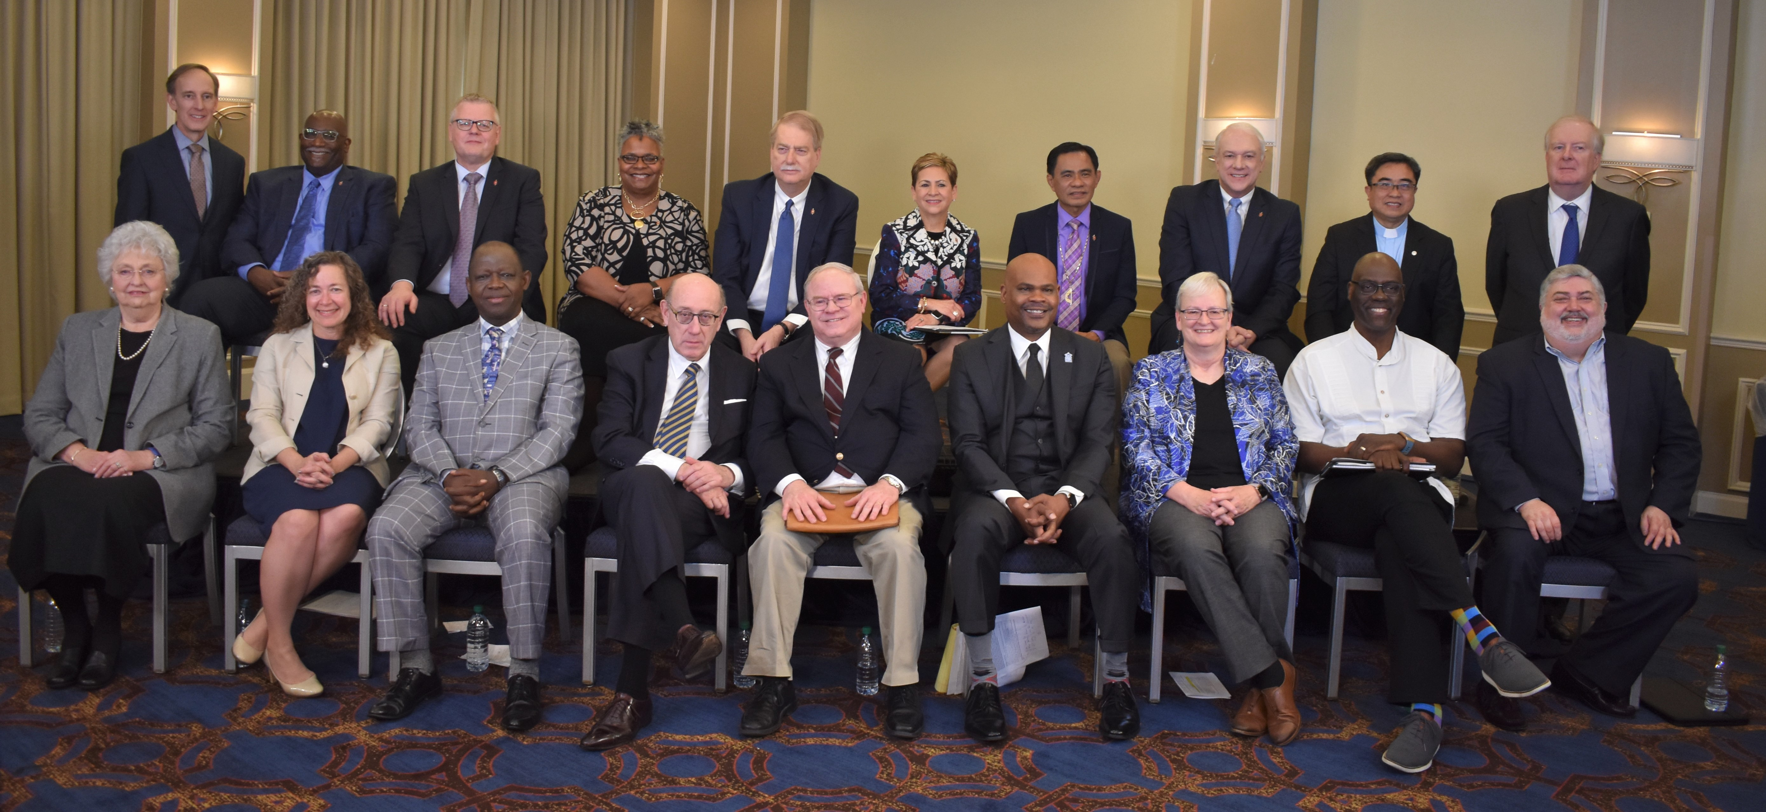

Slide 4
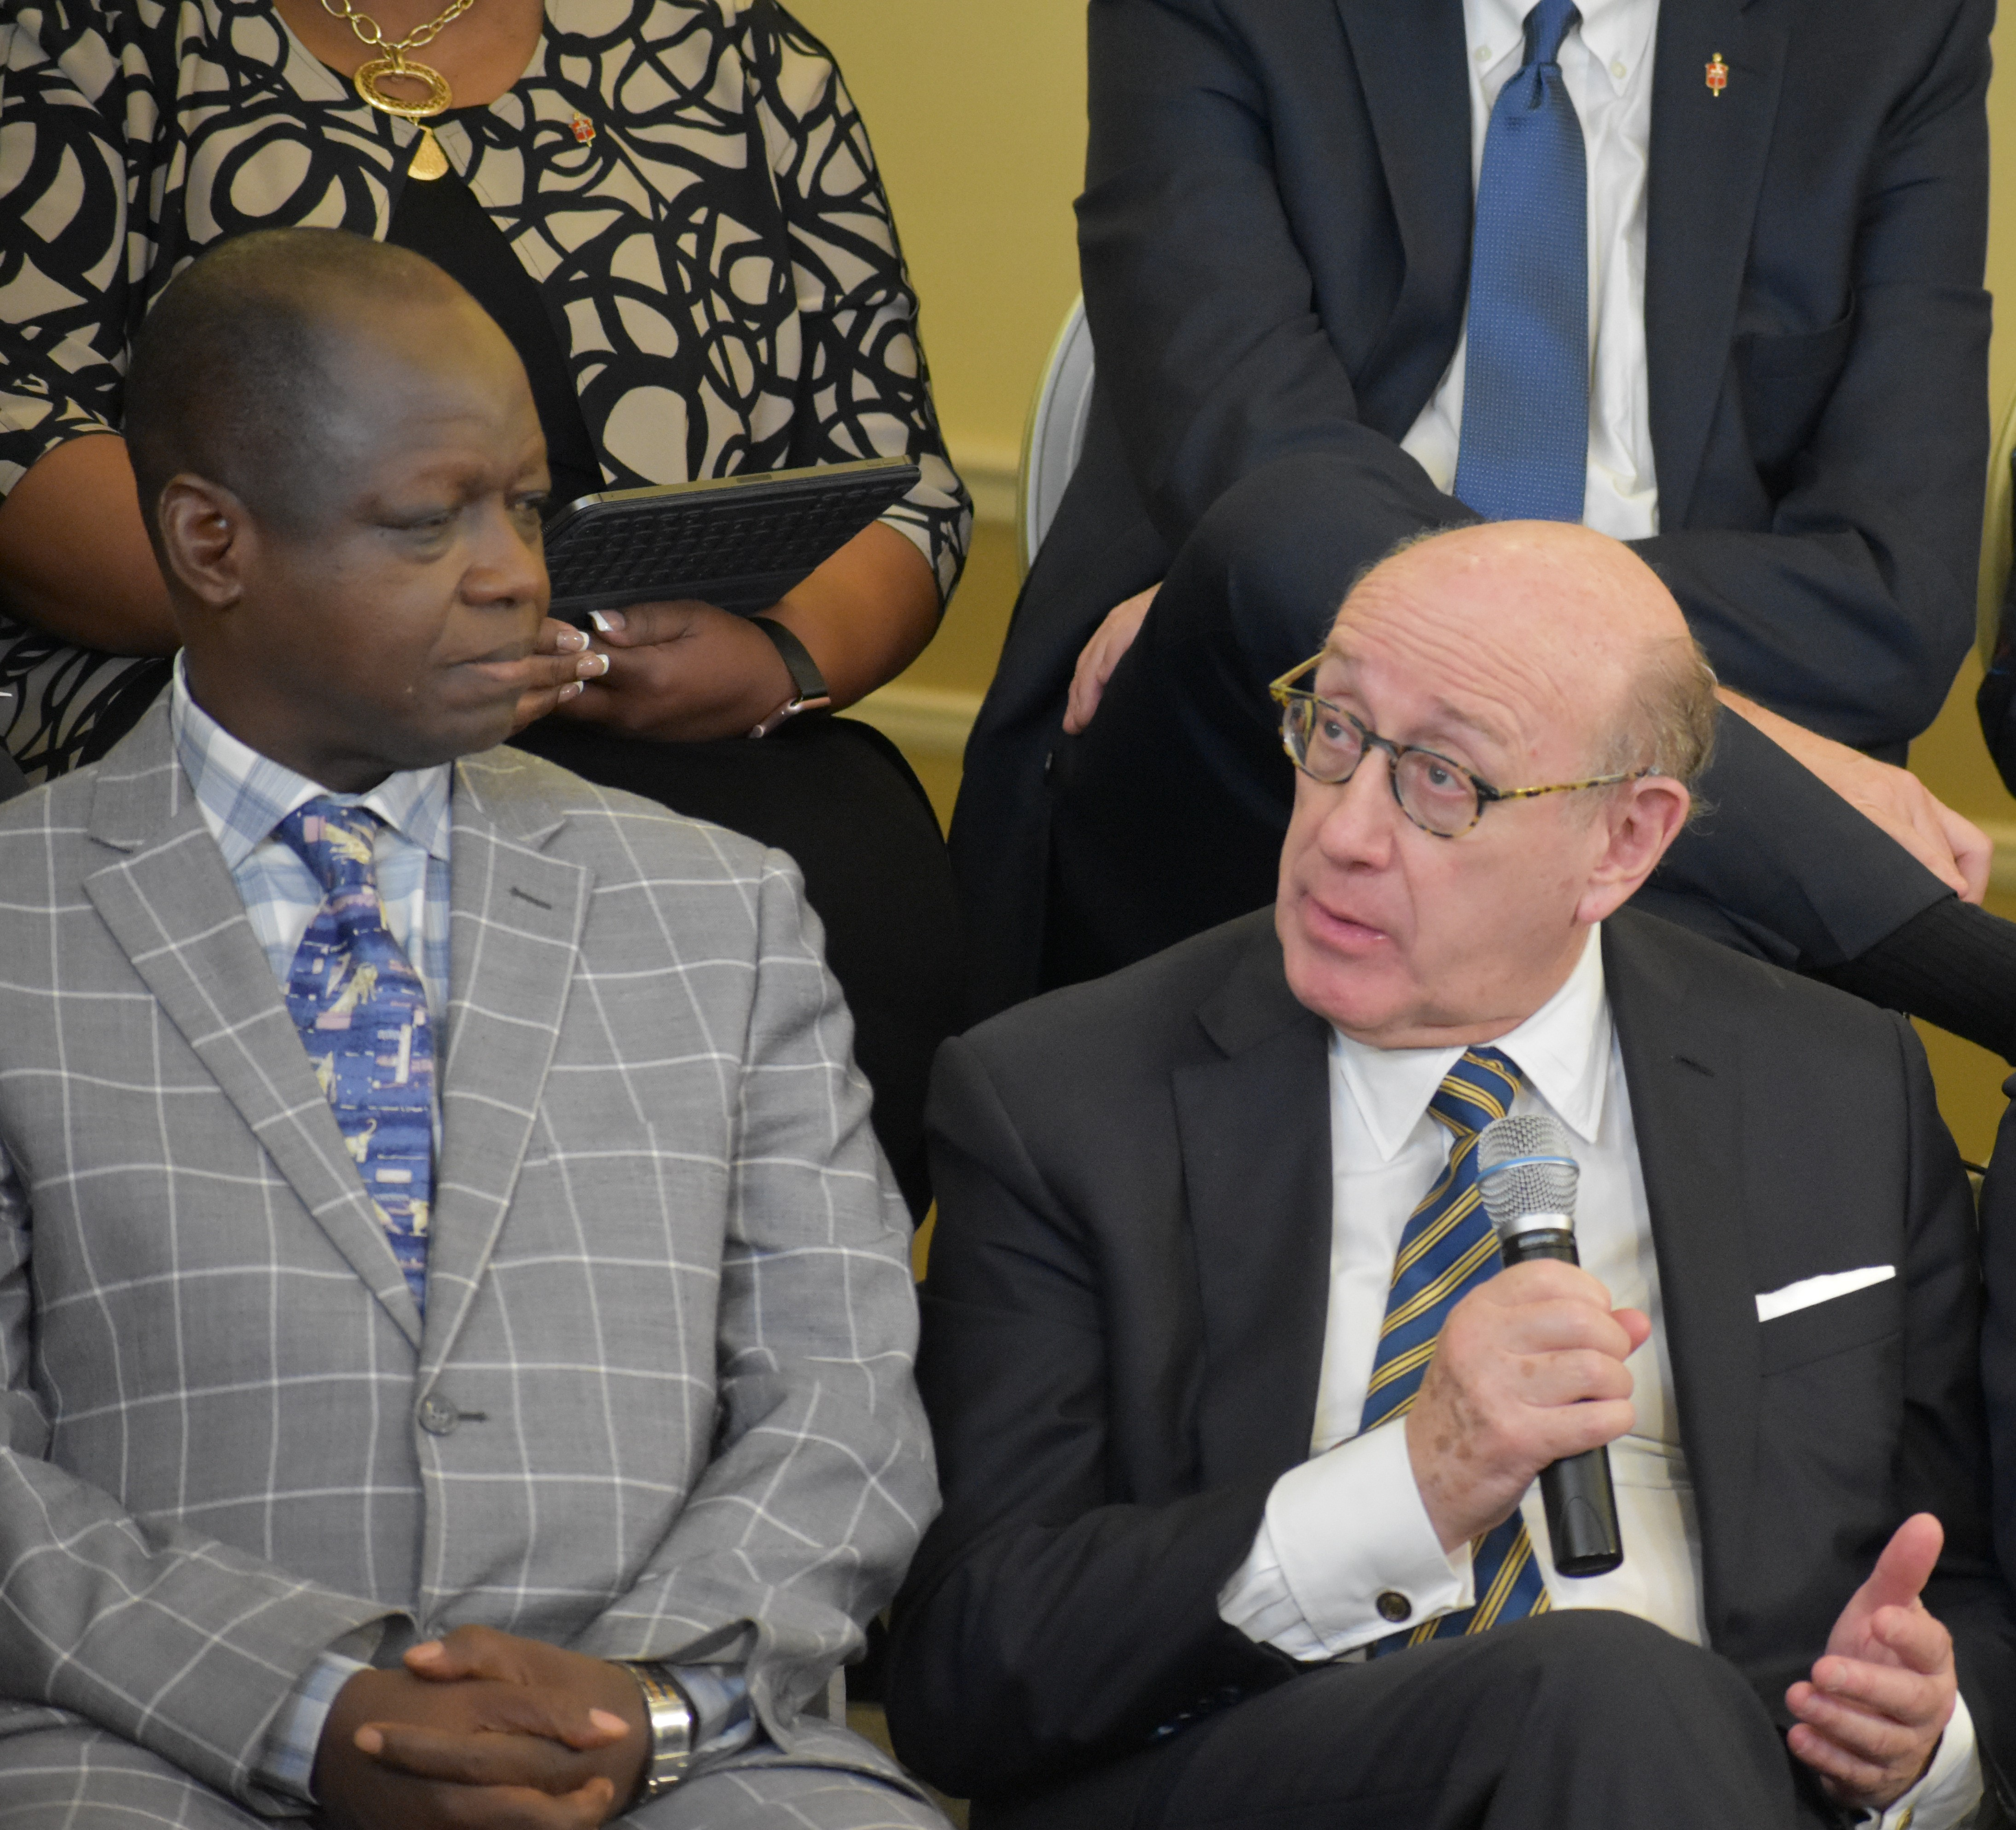
Kenneth Feinberg
Deepwater Horizon, 9-11 Fund, TARP, Boeing, GM, Volkswagen, Hokie Spirit Fund
Pro bono services – Six days of mediation along with meetings between sessions

